Slide 1

Introduction to Sequence Informatics
Institute of Infection and Global Health

Slide 2
Course overview
Session | Topic
1 | UNIX and command line environment
2 | Genomics: sequencing, assembly and annotation
3 | Programming in R
4 | Genomics: mapping and population analysis
5 | Transcriptomics and differential expression
6 | Extended exercise

Slide 3
Sequencing, assembly and annotation

Slide 4
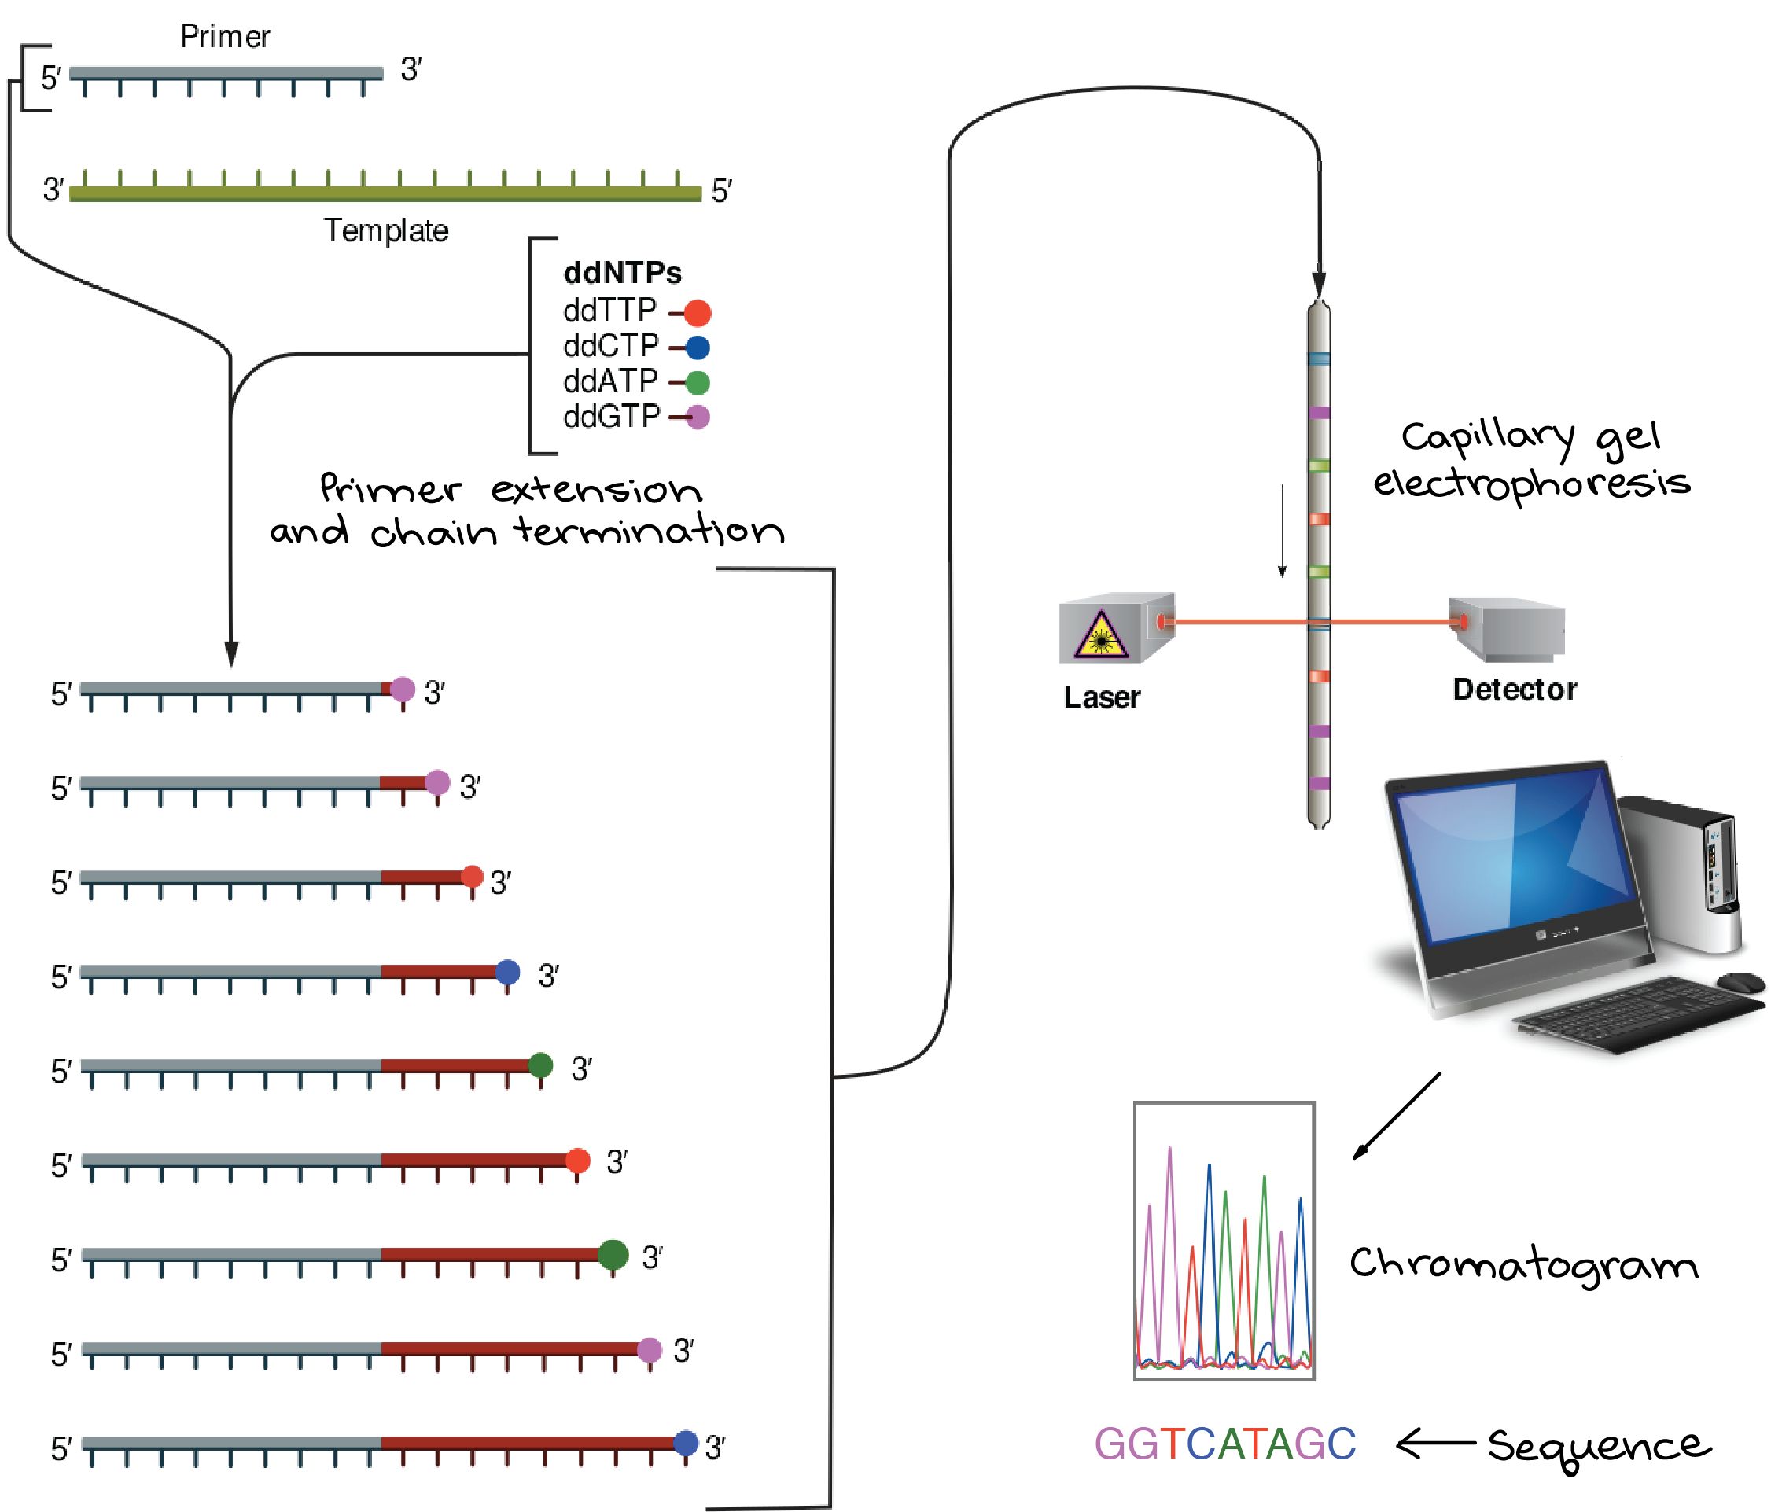
1st Generation Sequencing
Sanger capillary sequencing
1 locus at a time, reads up to ~1kb
Costs ~£5 per sequencing read
Requires clean DNA in relatively large quantities
High accuracy
High cost
Low throughput

Slide 5
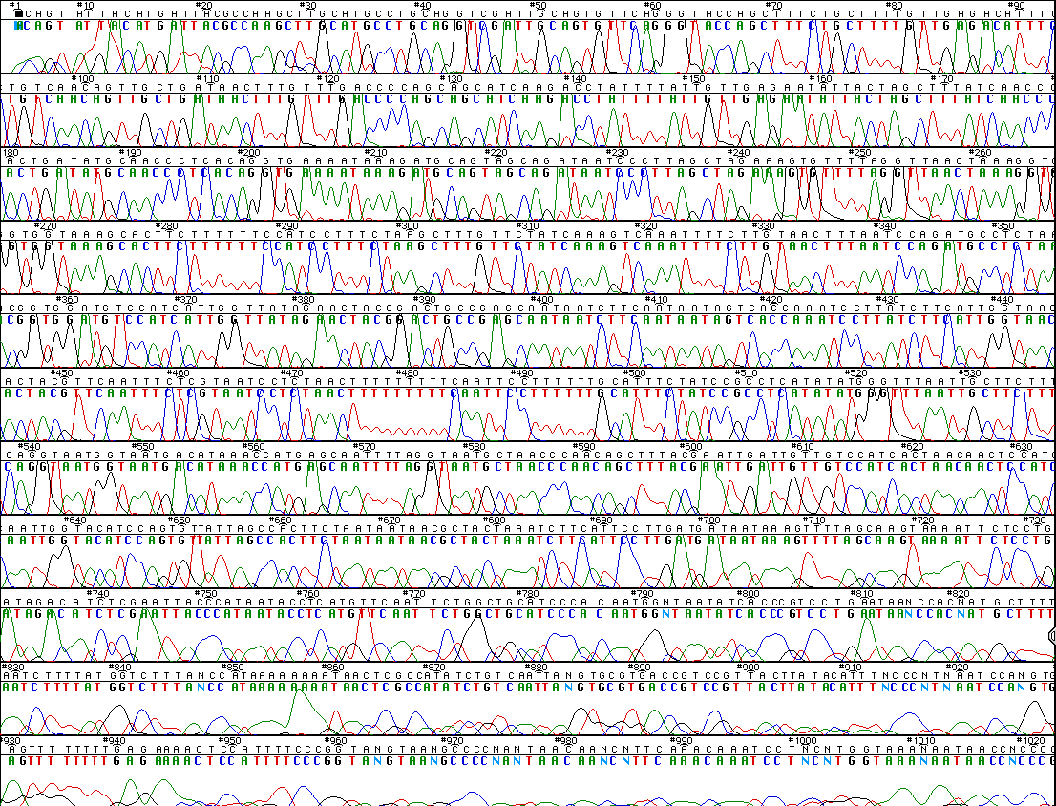

Slide 6
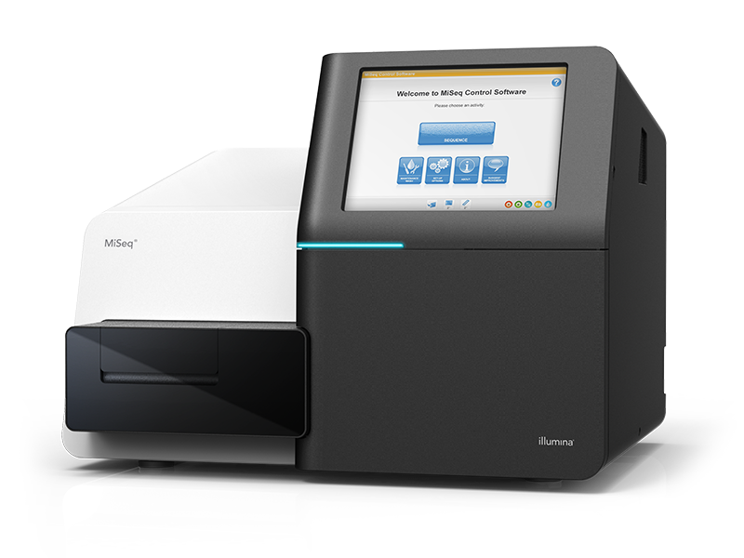
‘Next Generation’ Sequencing
Second generation sequencers utilise high-throughput approaches to generation millions of distinct reads from a single sequencing run.
While multiple technologies competed for marketshare Illumina has emerged as the dominant company.
Illumina sequencers are:
High throughput - Up to 400,000,000 reads / 120Gb of data
(30 x coverage of entire human genome)
Short read - 75-300bp
‘Low cost’ - <$1500 to sequence entire human genome*
*If you exclude the cost of the machine!

Slide 7
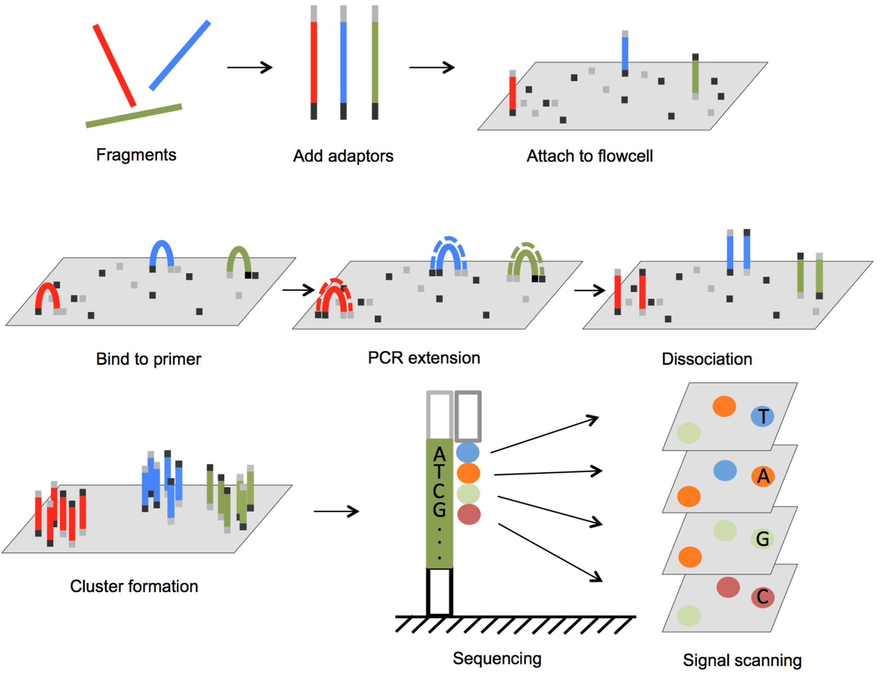
Sequencing by Synthesis
Illumina sequencers utilise a ‘sequencing by synthesis’ technology that incorporates fluorescently labelled nucleotides one base at a time.
Genomic DNA

Slide 8
Amplification on the flow cell generates clusters of ~1000 identical fragments

Slide 9
A single fluorescently labelled base is incorporates to each strand.

Slide 10
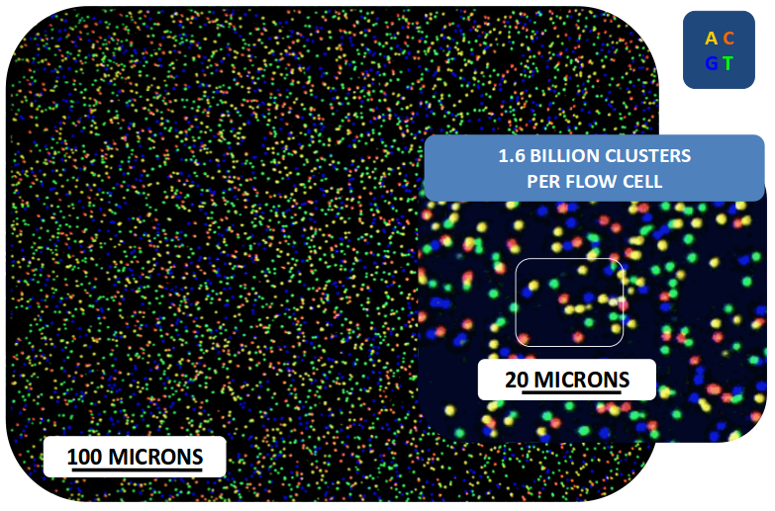
The flow cell is imaged, with each base represented by a distinct colour. After imaging the base is unblocked and the next one incorporated by the polymerase. This process is repeated for up to 300 cycles.

Slide 11
After one end of the fragment has been sequenced the process is repeated from the opposite end. This is known as paired-end sequencing.
Read 1
75-300bp
Read 2
75-300bp
Fragment of 500-800bp

Slide 12
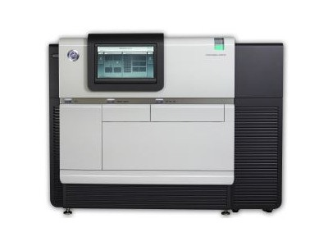
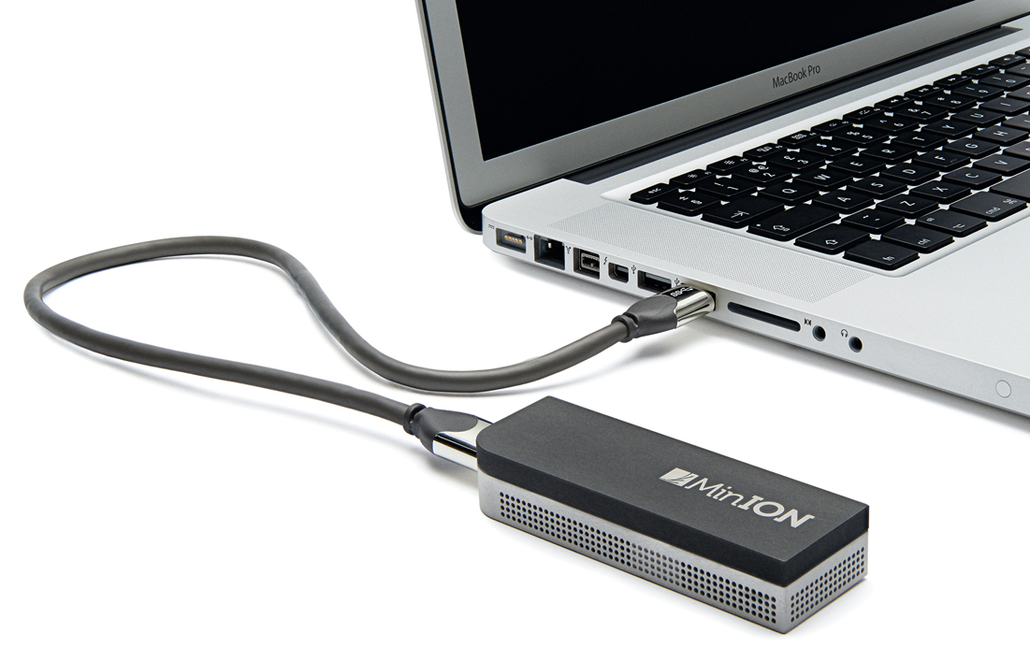
3rd Generation Sequencing
Two competing platforms - Pacific Biosciences and Oxford Nanopore
Average read lengths of 15-20kb
Ultra-long reads of up to 2Mb (2,000,000bp!) reported for Oxford Nanopore
Both platforms have relatively high error rates (10-15%)
Compared to Illumina the sequencers require large quantities of DNA
Both are rapidly improving

Slide 13
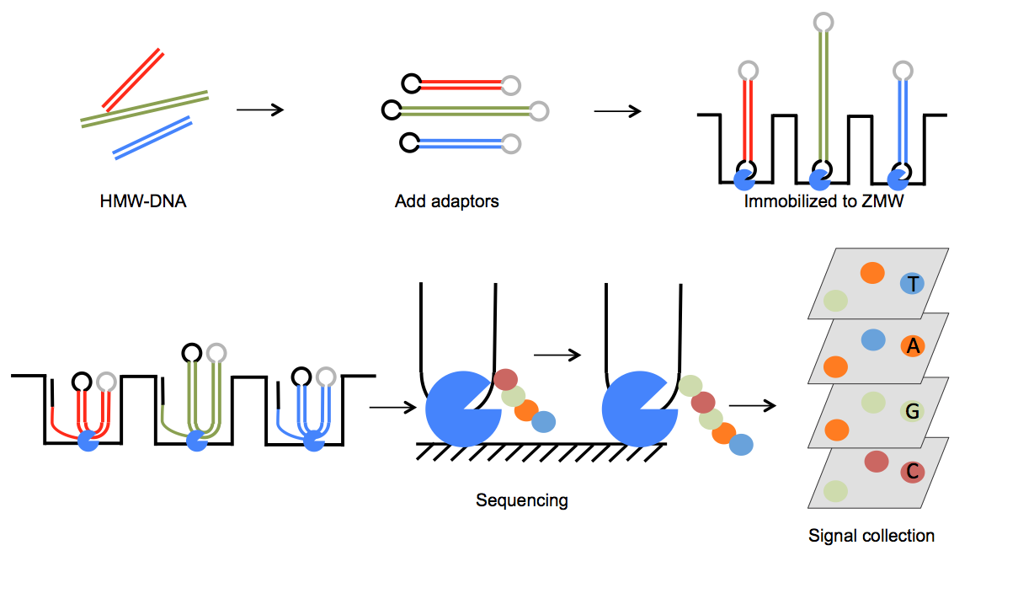
PacBio SMRT Sequencing

Slide 14
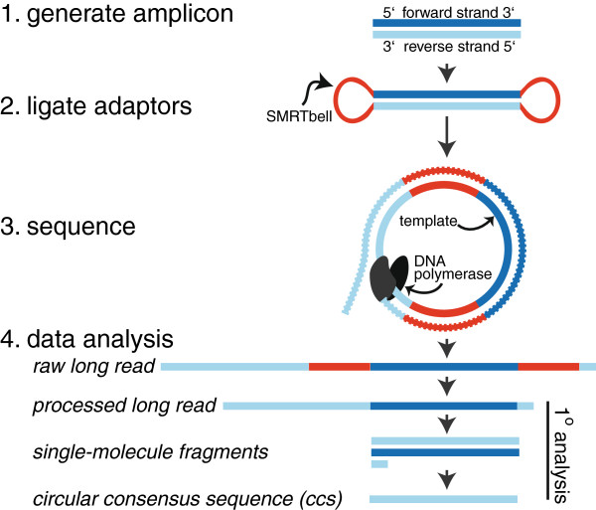
PacBio SMRT Sequencing

Slide 15
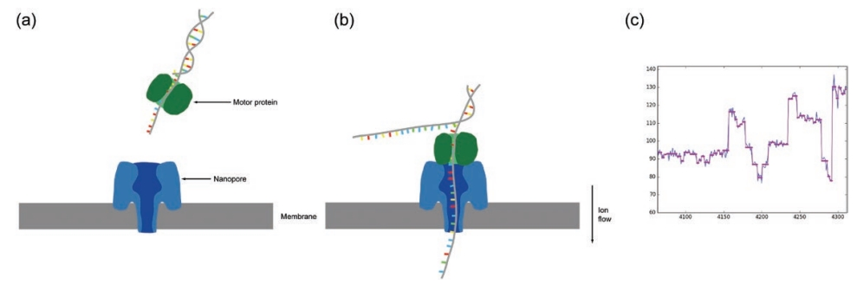
Oxford Nanopore Sequencing

Slide 16
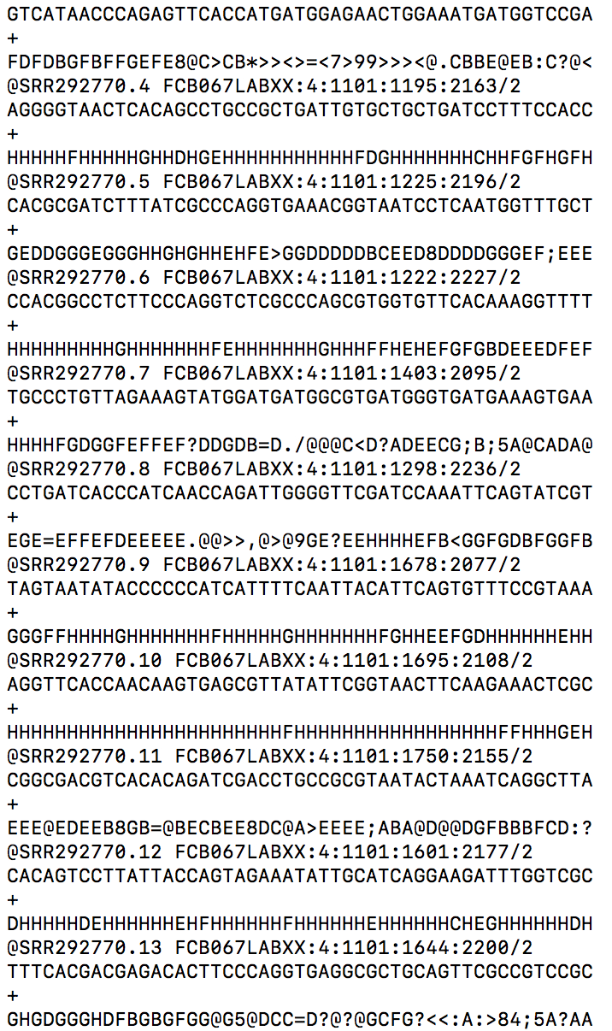
The fastq file
Read ID
Sequence
Spacer
Quality scores

Slide 17
De novo assembly

Slide 18
Reconstructing the genome
Two approaches - De novo assembly and Mapping

Slide 19
Reconstructing the genome
ACGTGTGTCGTCAACTGA
TCAACTGAACGGCGTGA
ACGTGTGTCGTCAACTGA
TCAACTGAACGGCGTGA

Slide 20
Reconstructing the genome
Individual contigs are unlikely to span the length of entire chromosomes
Assembly often struggles with repetitive regions and homopolymeric tracts
If we have a related genome we can scaffold the contigs to its chromosomes based on similarity using software such as MUMmer.

Slide 21
Reconstructing the genome
During Exercise One you will learn how to: Examine raw read data and assess its quality
Generate a hash database of of your reads
Assemble the reads into a completed genome using Velvet and Samtools
Compare your assembly to a reference sequence using MUMmer

Slide 22
Where are the handouts?
The remainder of the handouts and slides for this course are on the tryps server.
Before you start exercise 1 you must first work out how to download it the handout
The files are all in a directory called /archived/Informatics/handouts
You will need to work out how to copy them.

Slide 23
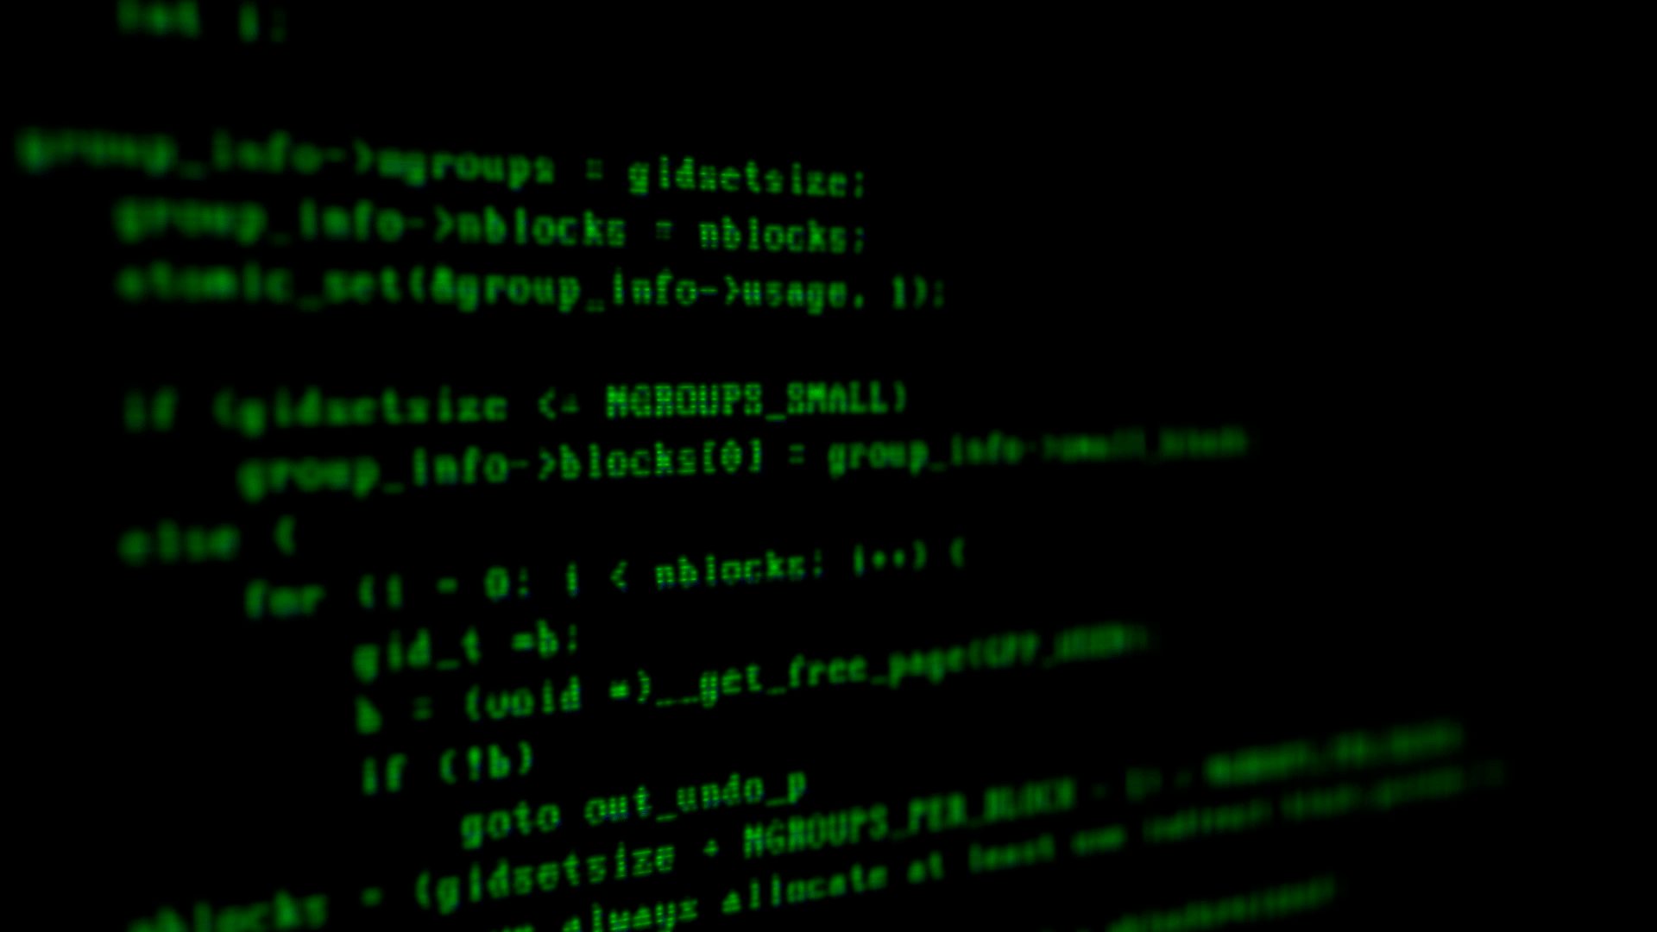

Slide 24
Annotating the genome
Annotation is the process of identifying and characterising features of interest within the genome
Features may include:
Genes
tRNA
Regulatory elements
Centromeres and telomeres
Non-coding RNAs
Two main types of approaches to annotation: Prediction and Similarity
Prediction based approaches use prior knowledge to identify motifs and structures within the genome. The software used for this often requires training, using annotation from closely related organisms
Similarity based approaches search for sequence similarity between your genome and an existing database. BLAST is an example of this approach.

Slide 25
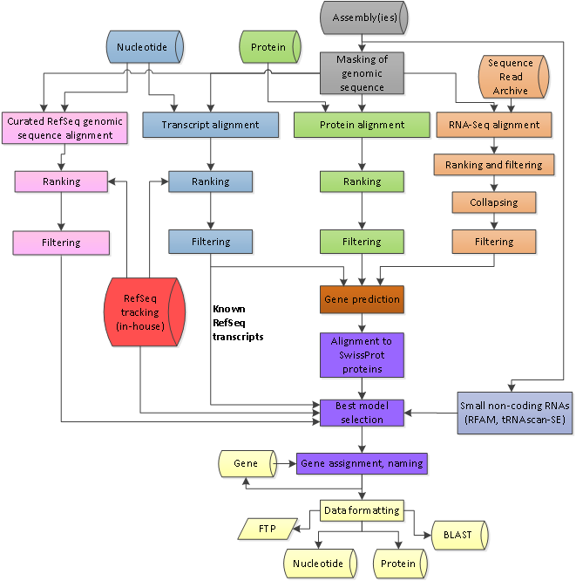
Annotating the genome
Annotation is a complex, multi-step process
Even automated pipelines require a significant amount of time and user input

Slide 26
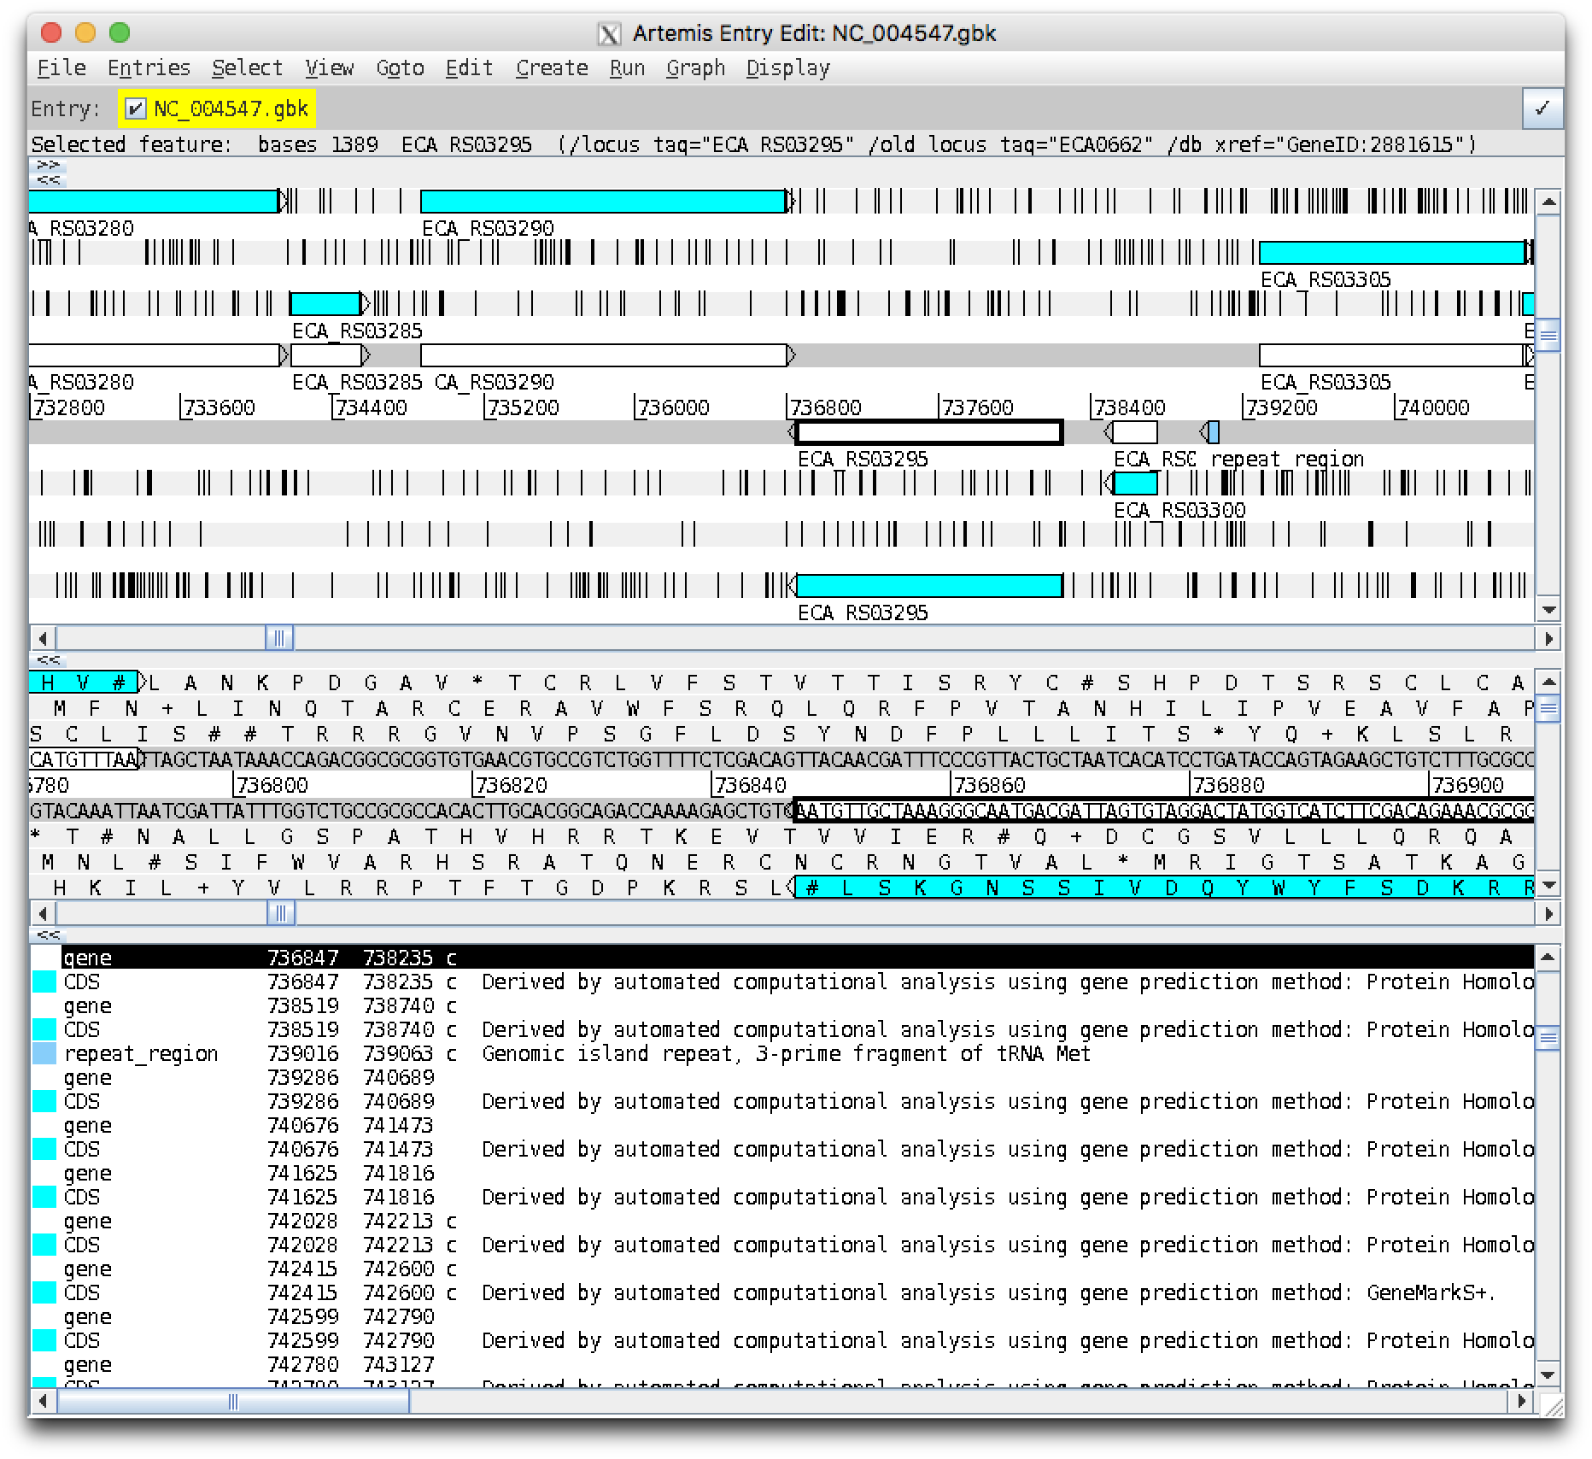
Annotating the genome
During Exercise Two you will: Load your assembly into Artemis, a popular program for examining genome assemblies
Identify open reading frames within your assembly
BLAST a small number of ORFs against the entire NCBI database to search for sequence similarity
Use InterProScan to search for protein similarity to further characterise your sequences

